Slide 1
Notes:
徐家汇辐射范围（康帕斯法则）http://wiki.mbalib.com/wiki/%E5%BA%B7%E5%B8%95%E6%96%AF%E6%B3%95%E5%88%99

Slide 2
Notes:
徐家汇

Slide 3
Notes:
中山公园

Slide 6
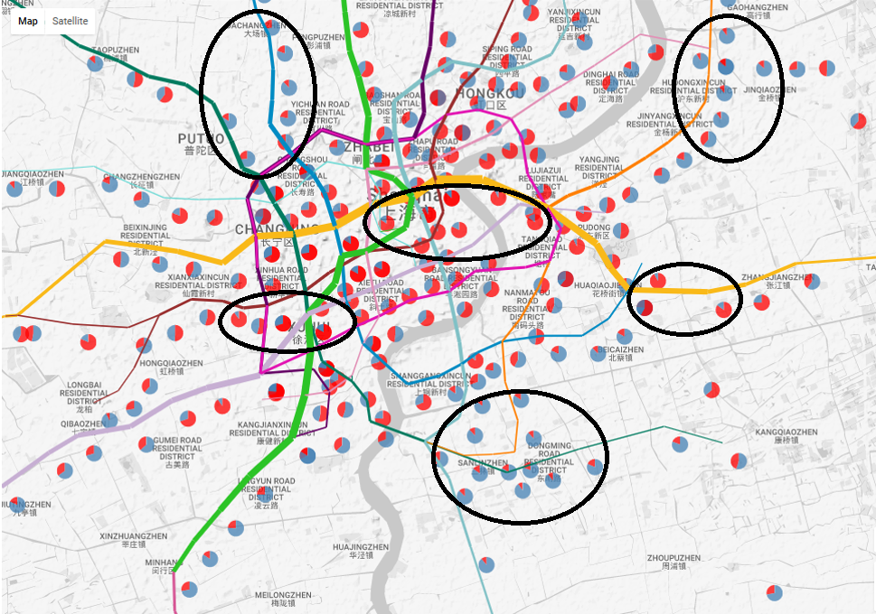
work area
residential area
residential area

Slide 8
Xujiahui
East Nanjing Road
Zhongshan Park
Longyang Road
Actual
Huff
Huff(subjective)
Huff(objective)
Ours

Slide 9
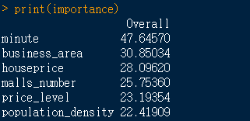

Slide 10
Xujiahui
East Nanjing Road
Zhongshan Park
Longyang Road
Trade Area
Customer

Slide 11
Xujiahui
East Nanjing Road
Zhongshan Park
Longyang Road
Actual
Ours
（Transfer times）
Ours

Slide 12

魔方集装箱网
魔方集装箱网

